Slide 1
Master of Data Science Capstone Project Glentel: Identifying Traits Associated with High Performance Clara Su Manuel Maldonado Robert Pimentel Thomas Pin Mentor: Varada Kolhatkar

Slide 2
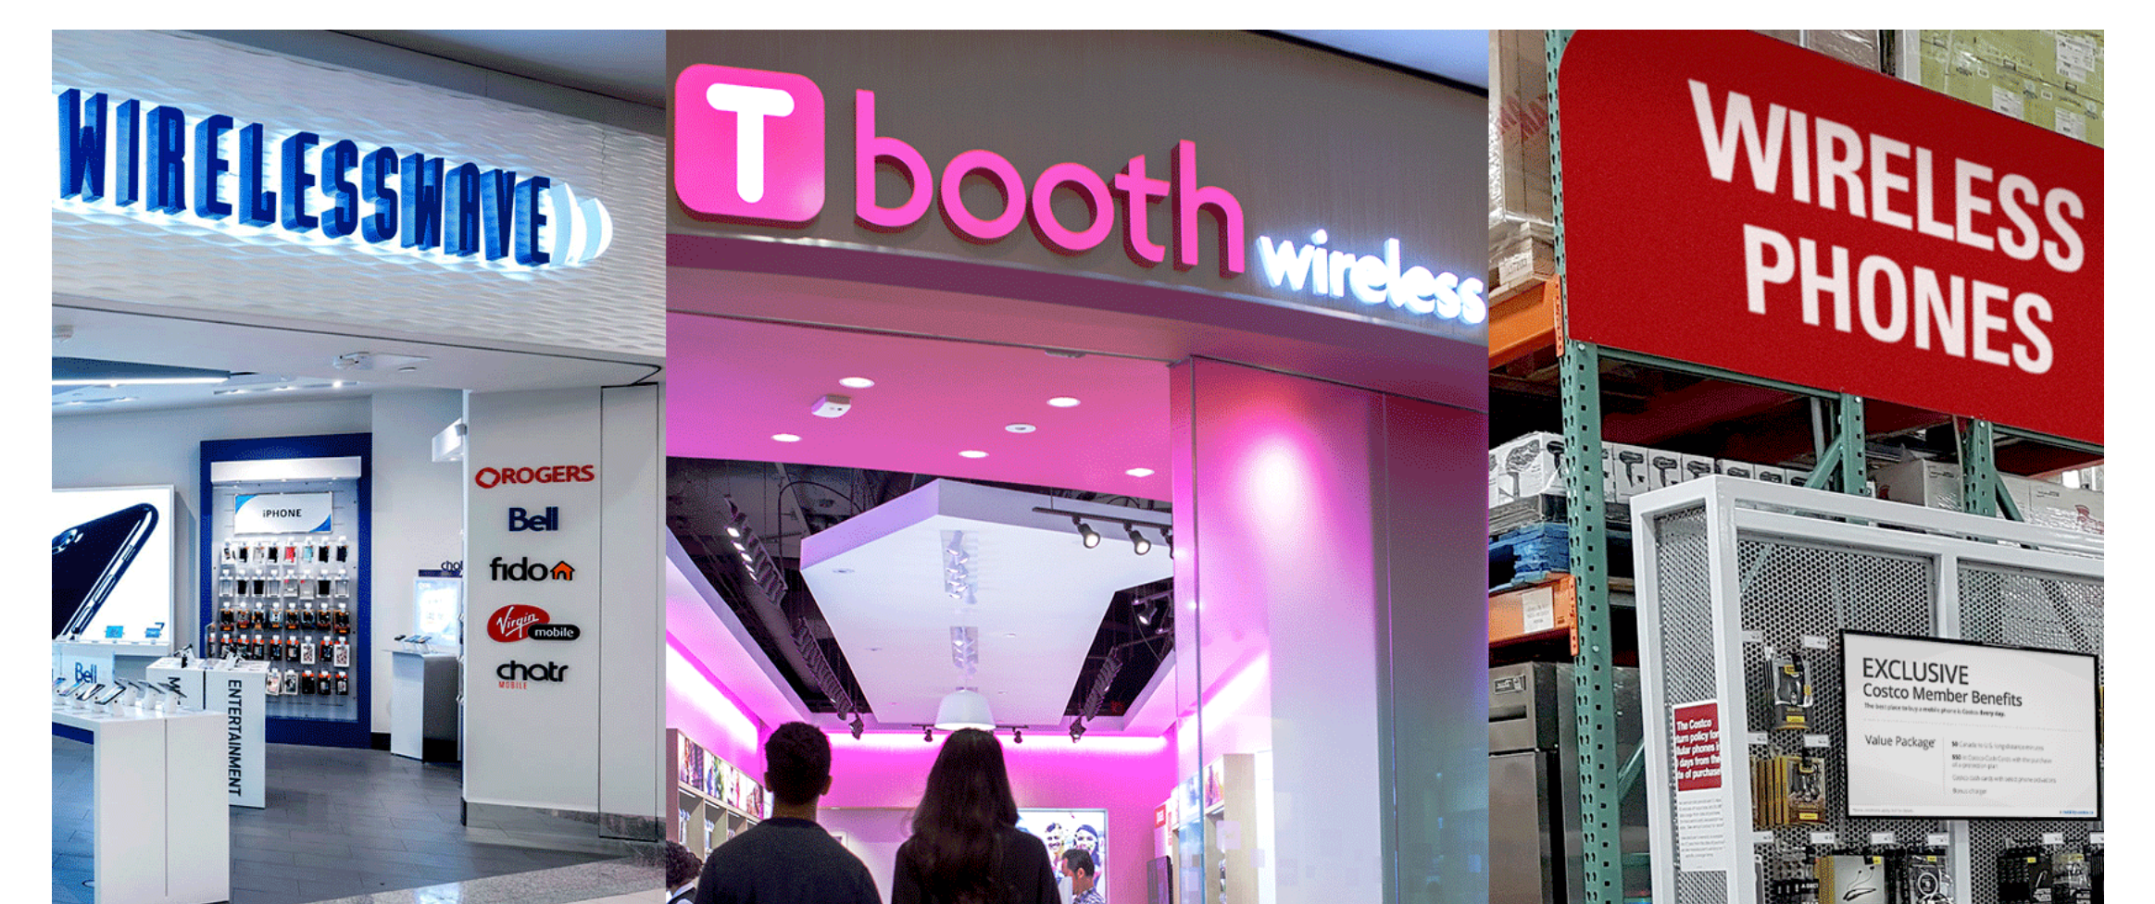
Glentel
Mobile phone retailer in Canada
Joint venture between Rogers Communications and Bell
Currently 2,000 employees:
Sales Associates
Assistant Manager
Sales Manager

Slide 3
Data Science Problem
HR wishes to understand what are the traits that are associated with employees who become “high performers”?
Why?
Increase productivity in sales performance
Decrease turnover rate in new hires

Slide 4
Scientific Objective
Identify the traits correlated to high performance through the development of a predictive model.

Slide 5
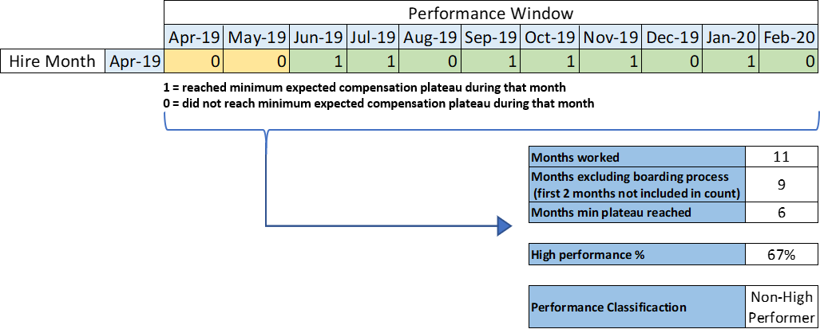
Who is a High Performer?
An employee who reaches the business expectations in 75% of the time
Business expectation is measured my monthly pay level reached
Example Employee
For the purposes of this analysis our definition was simplified high performance definition

Slide 6
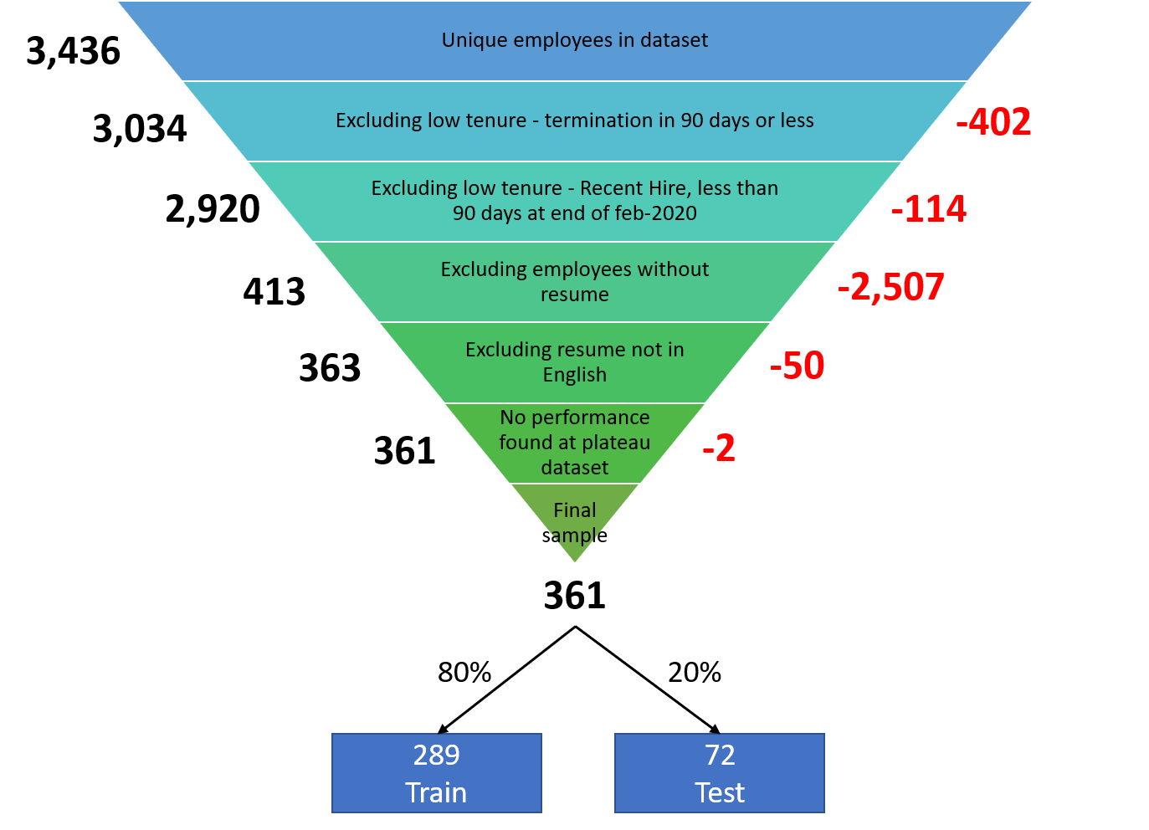
Data & Resume Filtering
Considerations
Main source of applicant traits is the resume
In order to measure performance we needed employees that:
Had worked at least 3 months in the company (The first two months are considered part of the boarding process)
Feb 2020 was the last month with “normal” performance, unaffected by COVID-19 Pandemic

Slide 7
Internal Definitions
Manual extraction: features engineered from manual extracted resume template
Automatic extraction: features engineered from the resume corpus directly

Slide 8
Methodology
Resume Filtering
Corpus Retrieval
Feature engineering from:
Manual extraction
Automatic extraction
Machine Learning Pipeline
Best Model
Traits

Slide 9
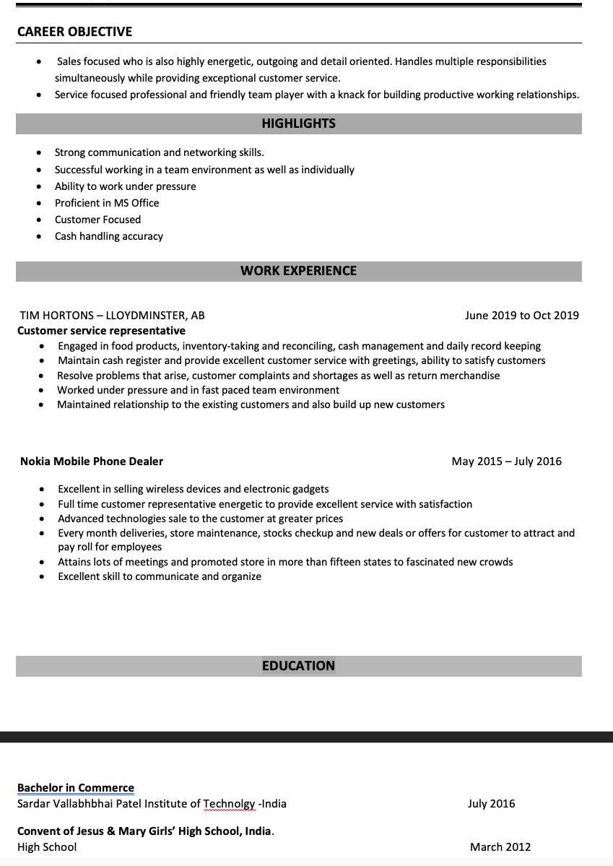
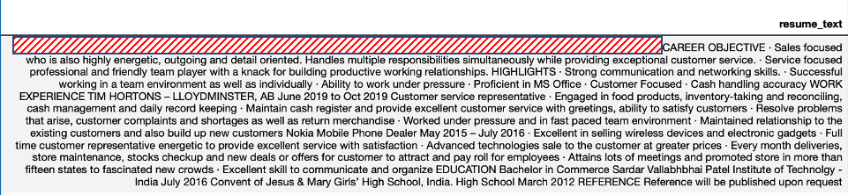
Corpus Extraction
Fictitious Resume Example
Different file formats (.pdf, .doc, .docx, .rtf, .txt)
Initial attempt to read data (1 wk)
pdf plumber (Slack Channel Recommendation)
python-docx (Win convert “doc -> docx” first)
Final Selection
Tika (Can work with many formats)
Plain Text Extraction

Slide 10
Feature Engineering

Slide 11
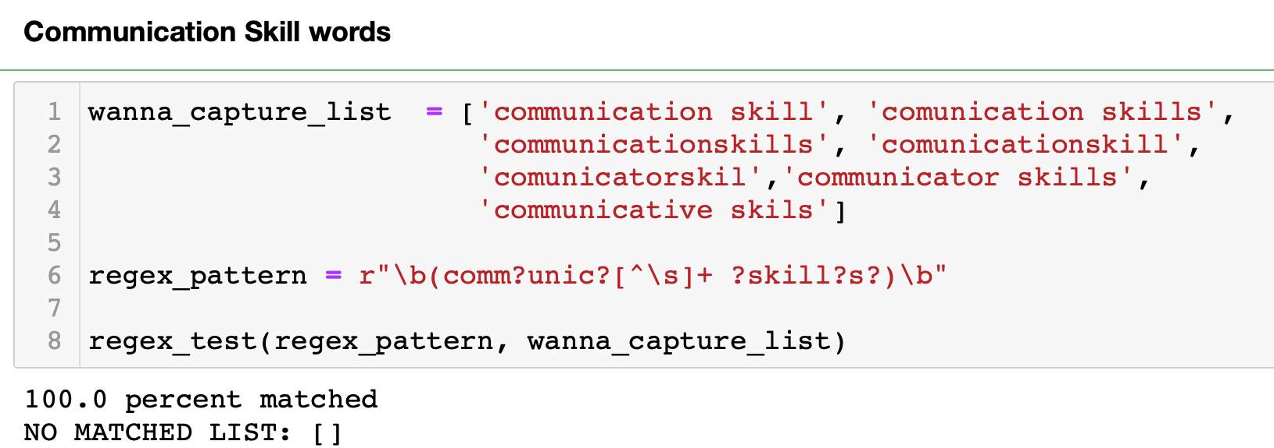
Feature Engineering Techniques
Automating Communication Skills Proxy using Regex
Regex
Exact match
Multiple patterns
Data cleaning
Grouping & lists
Segmented searching also created problems

Slide 12
Feature Engineering Techniques
Normalized Levenshtein Distance (Similarity Algorithm)
For example, the Levenshtein distance between “kitten” and “sitting” is 3,
kitten => sitten (substitute “k” for “s”)
sitten => sittin (substitute “e” for “i”)
sittin => sitting (insert “g” at the end)
Identify short strings in longer text with smalls differences
No need to encode words into vectors such as Word2Vec
Only 10 – 15% effectiveness

Slide 13
Feature Engineering (Industry Characterization)
REGEX Key Words + Levenshtein
Wikipedia company list Levenshtein Only
Industry | Count employees | %
Unknown | 349 | 32.3
Telecommunications | 252 | 23.3
Food Service | 109 | 10.1
Sport_Travel_ Enterntain_Hotel | 65 | 6.02
Food_Convenience_Pharmace | 65 | 5.46
Clothing & Footwear | 59 | 2.68
Industry | Count employees | %
Unknown | 920 | 85.3
Consumer Electronic | 252 | 3.3
Clothing & Footwear | 109 | 2.4
1079 companies

Slide 14
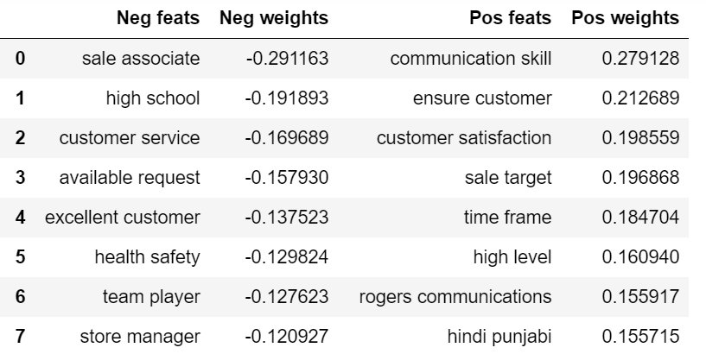
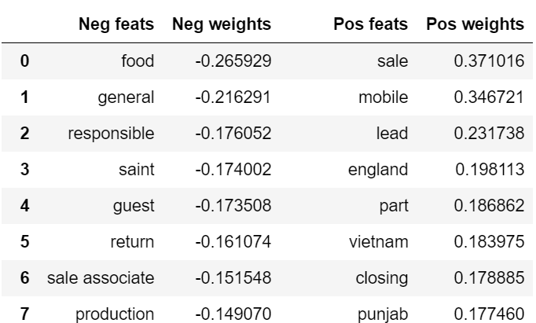
TF-IDF
Feature Engineering (Bag-of-Words)
BOW
BOW and TF-IDF helped us in the feature generation process:
Number of languages spoken
Highest educational degree

Slide 15
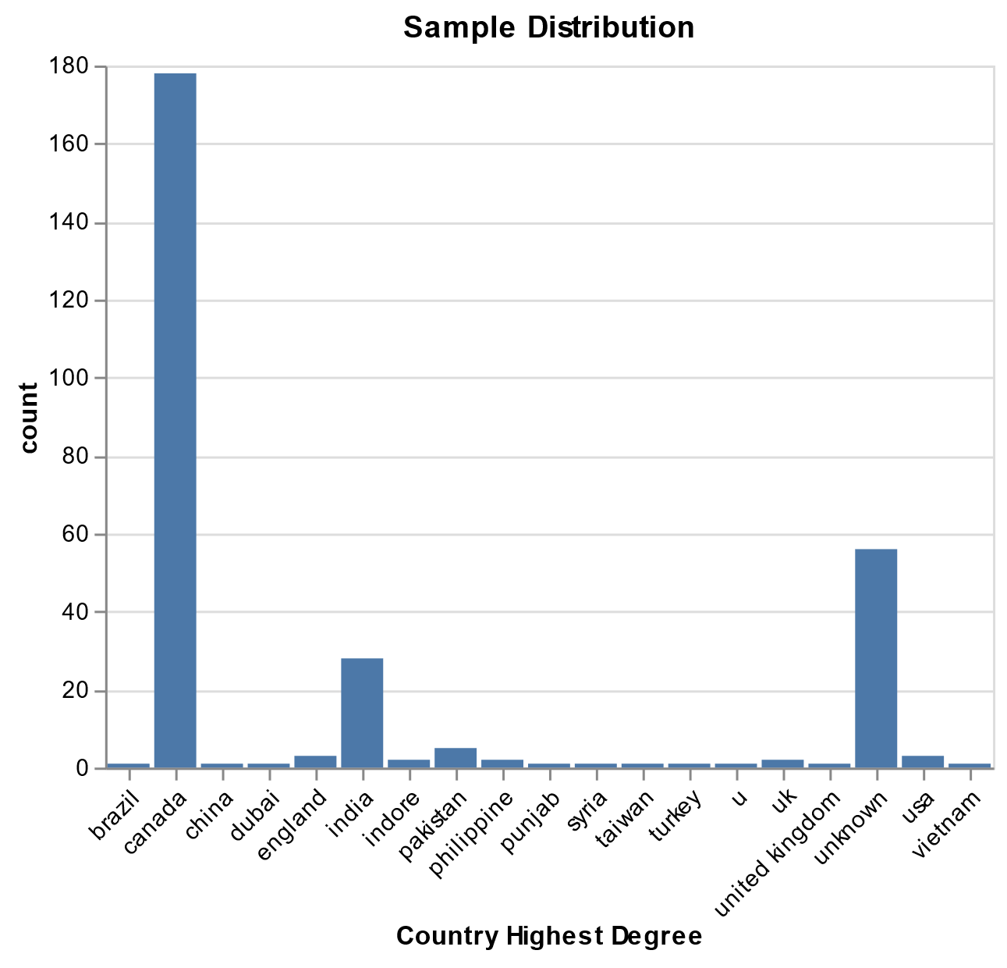
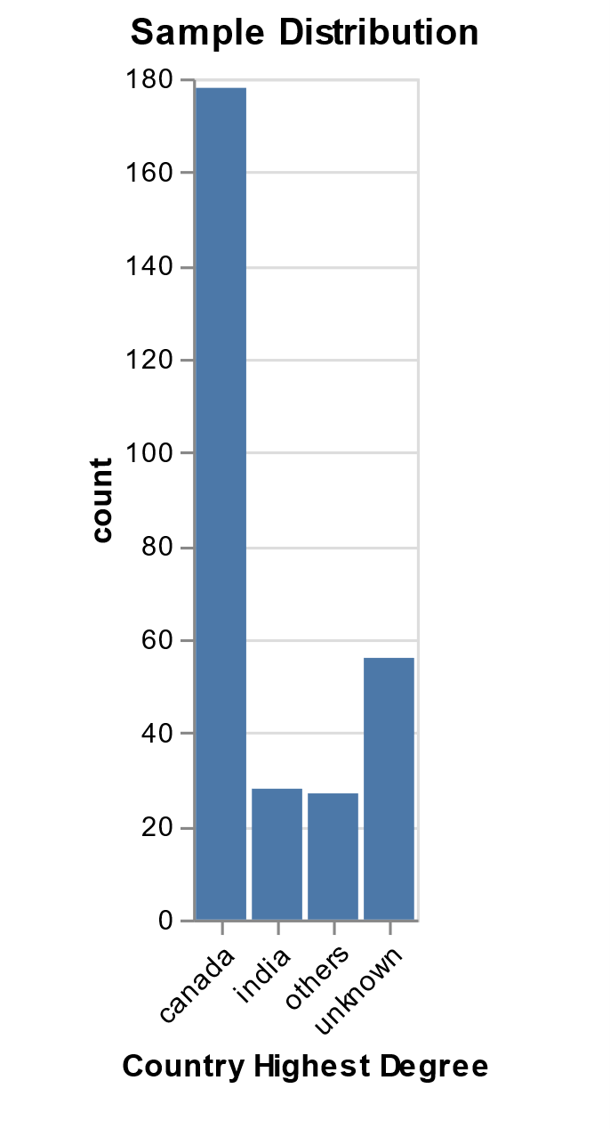
Feature Engineering - Grouping
Country where educational degree was studied in
Consolidated low count features to increase interpretability

Slide 16
Methodology – Feature Engineering Summary
Example Final Modeling Features
knowledge_and_skills
trilingual_flag
volunteer_exp
problem_solving
job_tenure_general
job_hopper
shortest_tenure
education_level
flag_hd_highschool
highest_degree
Final Model Set
11 Feature groups
61 Numeric features
7 Categorical features
Notes:
shortest_tenure

Slide 17
Machine Learning Pipeline

Slide 18
Machine Learning Modeling - Workflow
Data splitting
80/20 train-test
Preprocessing:
One hot encoding, Standardization, Imputation
Feature selection
L1 regularization, RFE
Hyperparameter tuning
Classifiers: Dummy, Logistic Regression,
SVM, Random Forest, XGBoost, LGBM,
Multi-layer perceptron
Handle imbalance data: tune class_weight
Model selection
Key metric: F1 score (due to imbalance dataset)
Cross-validation scores and error bar (many iterations)
test scores (final step)
Feature experiment

Slide 19
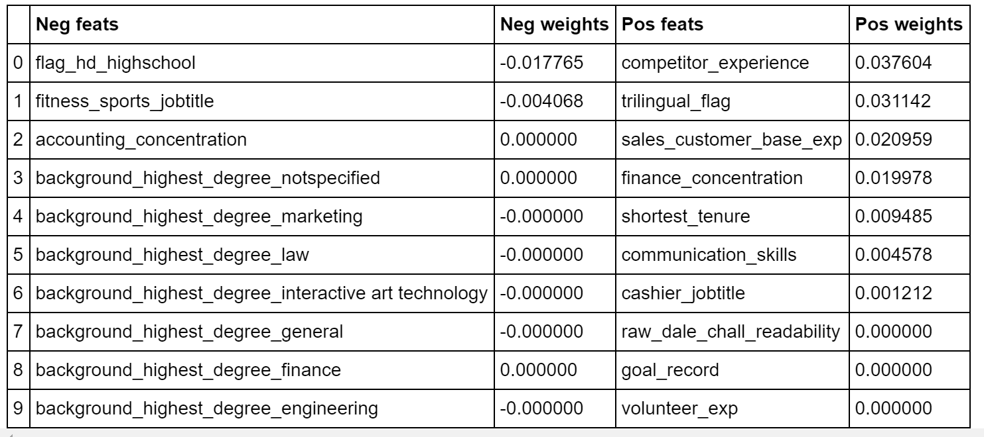
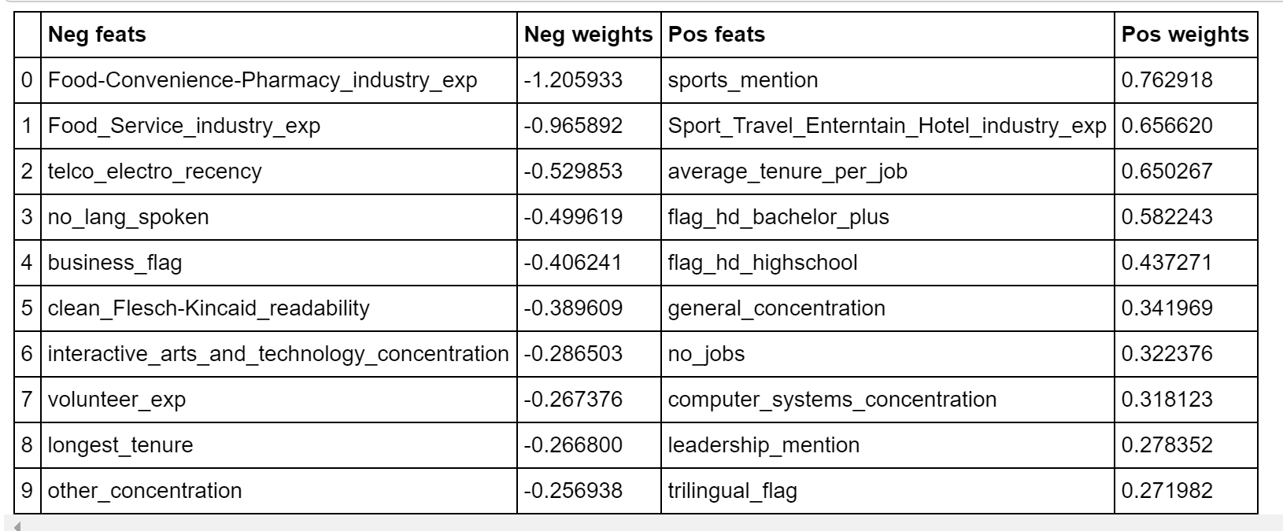
Machine Learning Modeling - Feature Selection
LassoCV
REFCV
* Only showing 20 features
46 features selected
REF did not handle Multicollinearity well
Selected features contradict behavior observed bar plots of features vs HP flag
9 features selected
All features make sense
Use LassoCV selected features

Slide 20
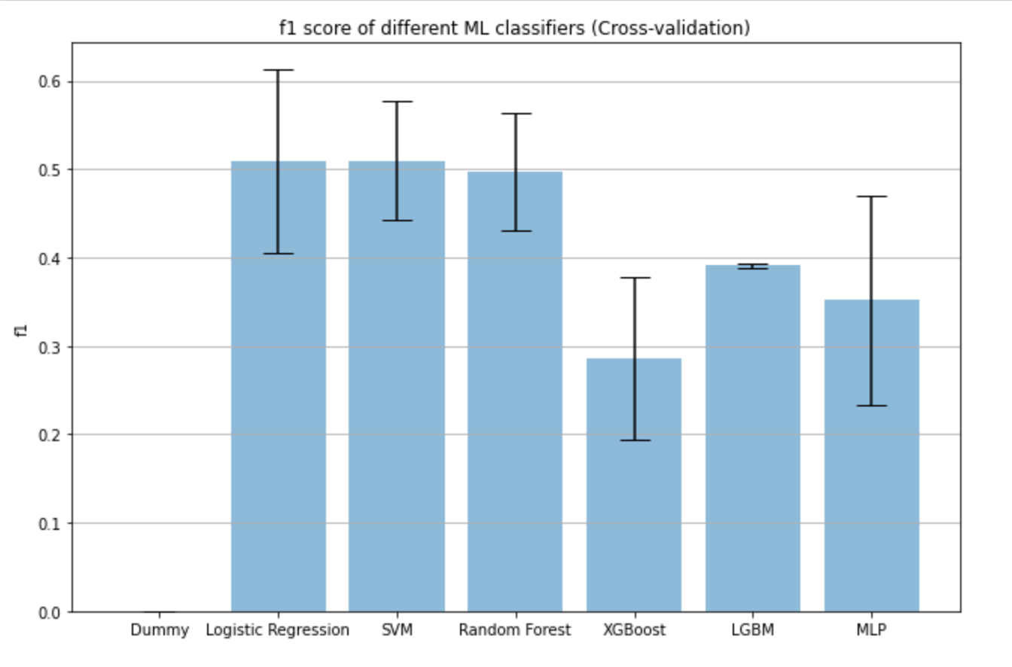
Machine Learning Modeling – Model Selection
F1 Scores with error bar (Cross-validation)
Cross-validation and test scores
Finalist model: Logistic regression
better interpretability, less overfitting issue

Slide 21
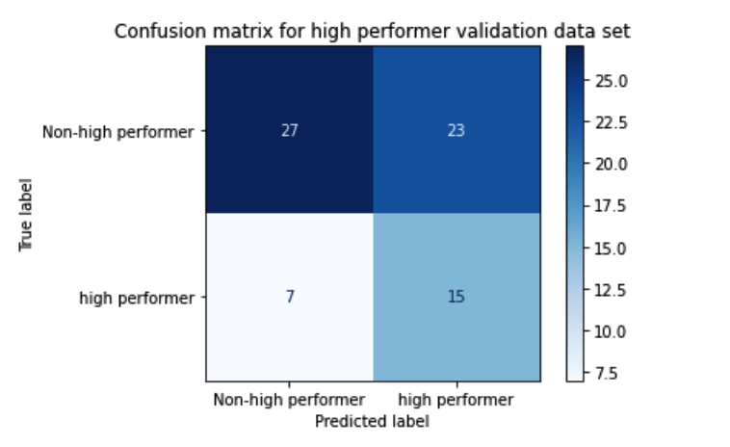
Machine Learning Modeling – Evaluation
Confusion matrix for high performer in testing dataset
Our finalist model was able to
predict ~70% high performers
even though only 30% of employees in
the testing dataset are high performers

Slide 22
Machine Learning Modeling - Comparison Feature
Baseline:
Use BOW and TF-IDF only
Include all informative features generated by feature engineering
Exclude one group of features each time

Slide 23
Interpretation (Dashboard)

Slide 24
Data Product Handoff
Documented GitHub repository
Makefile to reproduce the analysis’s pipeline
Conda virtual environment with requirements preinstalled

Slide 25
Challenges
Sample size
Unstructured resume corpus
Feature creation and interpretation

Slide 26
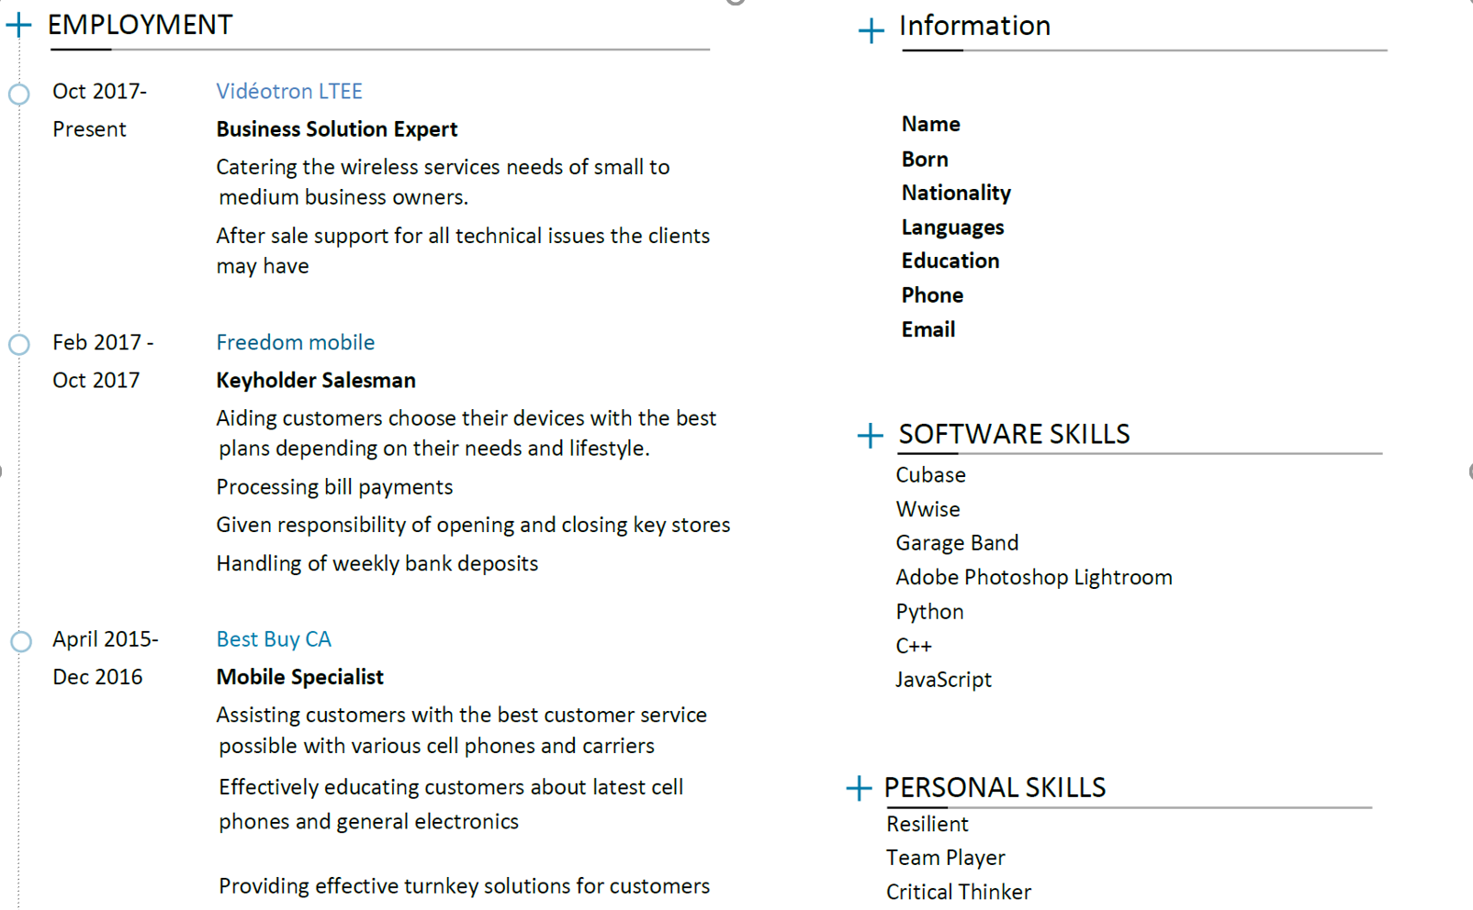
Recommendation
Adobe Photoshop Lightroom
Python
C++
JavaScript
SOFTWARE SKILLS
BestBuy CA
District employee of the month, Aug
2016
Employee of the month, May, June 2016
AWARDS
RESUME
Sept 2018- Music Industry Arts.
Spacy automated information extraction
Automatic annotation tools: Prodigy from Spacy, Inception.

Slide 27


Recommendation
Job 1
Start Date
End Date
Job Title
Company
Job 2
Start Date
End Date
Job Title
Company
Job 3
Start Date
End Date
Job Title
Company
Job 4
Start Date
End Date
Job Title
Company

Slide 28
Questions?

Slide 29
Appendix

Slide 30
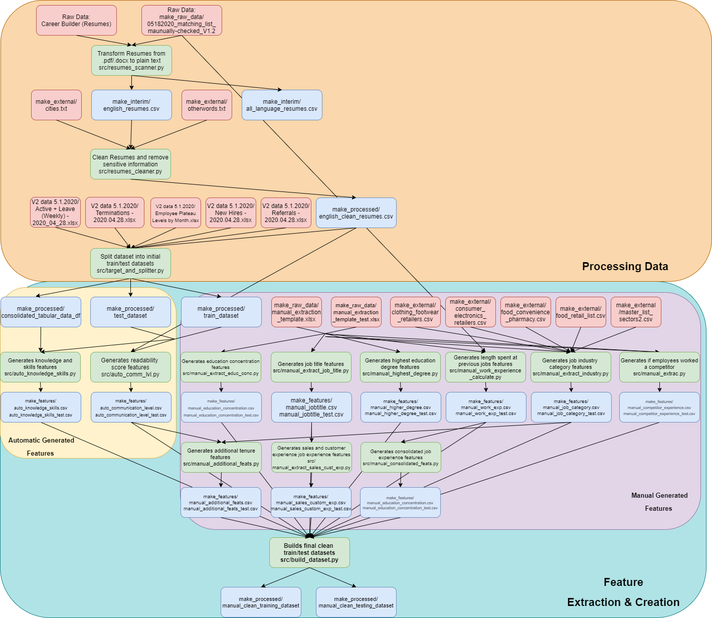
Script Dependency Appendix

Slide 31
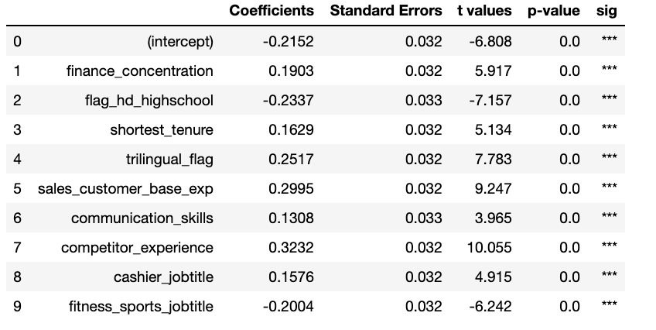
P-values of the logistic regression

Slide 32
Methodology - Expectations
Resume Filtering
Automatic resume Structuring Algorithm
Corpus Extraction
Automatic structured resume accuracy validation
Feature Engineering from structured corpus
Manual resume structuring
Machine Learning Pipeline
Best Model
Traits

Slide 33
Methodology - Reality
Multiple date formats
Multiple resume segment order
Different resume designs were not being correctly transformed into text.
Resume Filtering
Corpus Structuring Algorithm
Corpus Extraction
Information Retrieval accuracy validation
Feature Engineering from structured corpus
Manual information retrieval
Machine Learning Pipeline
Best Model
Traits

Slide 34
Information Retrieval
Raw Text/Corpus Extraction
Structured Text
'\n\n\n\n\n\n\n\n\n\n\n\n\n\n\n\n\n\n\n\n\n\n\n\n\n\n\n\n\n\n\n\n\n\n\n\n\n\n\n\n\n\n\n\n\n\n\n\n\n\\n\n\nSKILLS & Competencies\n· Experienced in public relations, rapport building, coordination, collaboration and team-work\n· Strong analytical and mathematical skills\n· Ability to identify issues, propose and implement solutions \n· Excellent verbal and communication skills attained by extensive client dealings \n· Proficient in MS Word, Excel and PowerPoint\n· Strong interpersonal, and communication skills\n· Highly creative and organized\n· Positive energy, “can-do” attitude, adaptive and high degree of initiative\n\n\nWORK EXPERIENCE\n\nTD CANADA TRUST Oct’18-Present \nCustomer Experience advisors.\n\nTHE MOBILE SHOP (Loblaws) Jan’16 – Oct’18 \nSales Associate the cleanliness of cars, gas levels and ensure they were ready for clients\n\n\nEXTRA CURRICULAR ACTIVIES \nUNITED SOUTH ASIANS AT YORK, YORK UNIVERSITY Sept’16 – Apr’16 \nVice President, Finance \n· Ensured \n·Responsible for maintaining a record of the financial standing and to oversee the financial management\n\n\nEDUCATION\nYORK UNIVERSITY Sept’15- Present \nBachelors of Commerce - Financial Economics \n\n\nCERTIFICATIONS\nIFIC (Mutual Funds License) March’18\n \n\n\n'
{'skills': ['· experienced in public relations, rapport building, coordination, collaboration and team-work',
'· strong analytical and mathematical skills',
'· ability to identify issues, propose and implement solutions ',
'· excellent verbal and communication skills attained by extensive client dealings ',
'· proficient in ms word, excel and powerpoint',
'· strong interpersonal, and communication skills',
'· highly creative and organized',
'· positive energy, "can-do" attitude, adaptive and high degree of initiative'],
'work experience': ['td canada trust',
'oct’18-present',
'customer experience associate',
'· efficiently handle customers by getting the task done in a timely manner.',
'vice president, finance',
'· ensured budget is adhered according to the approved student association ',
'· responsible for maintaining a record of the financial standing and to oversee the financial management'],
'education': ['york university',
'sept’15- present',
'bachelors of commerce - financial economics',
'certifications',
'ific (mutual funds license)',
'march’18']}

Slide 35
We noticed some resume designs were not being correctly transformed into text:
Line order is being altered when transformed into text.
Information
Cubase
Wwise
Garage Band
Adobe Photoshop Lightroom
Python
C++
JavaScript
SOFTWARE SKILLS
BestBuy CA
District employee of the month, Aug
2016
Employee of the month, May, June 2016
AWARDS
RESUME
Sept 2018- Music Industry Arts.
Present Dep. Of Art Media and Design
Algonquin College
Sept 2013- Bachelor of Computer Science
Algonquin College
Sept 2013- Bachelor of Computer Science
April 2016 Software Engineering stream
Carleton University

Slide 36
We also noticed the lack of structure and consistent patterns within each resume segment.
Name: employee_code, dtype: object
Out[251]:
['sales associate rogers2018-2019',
'sales associate la naturess2015-2017 ',
'cashier and customer service urban planet 2014-2015 ',
'cashier (part time) shoppers drug mart 2013-2014',
'sales representative amarat afghan carpets2010-2013',
'reference available on request ']
Name: employee_code, dtype: object
Out[254]:
['sales associate/manager in training ',
'bell canada',
' september',
'2018 – present ',
'1920 dundas street, london, on n5v 3p1 ',
'shift supervisor/closing manager ',
'jersey mike’s subs',
' march 2018 – september 2018 ',

Slide 37
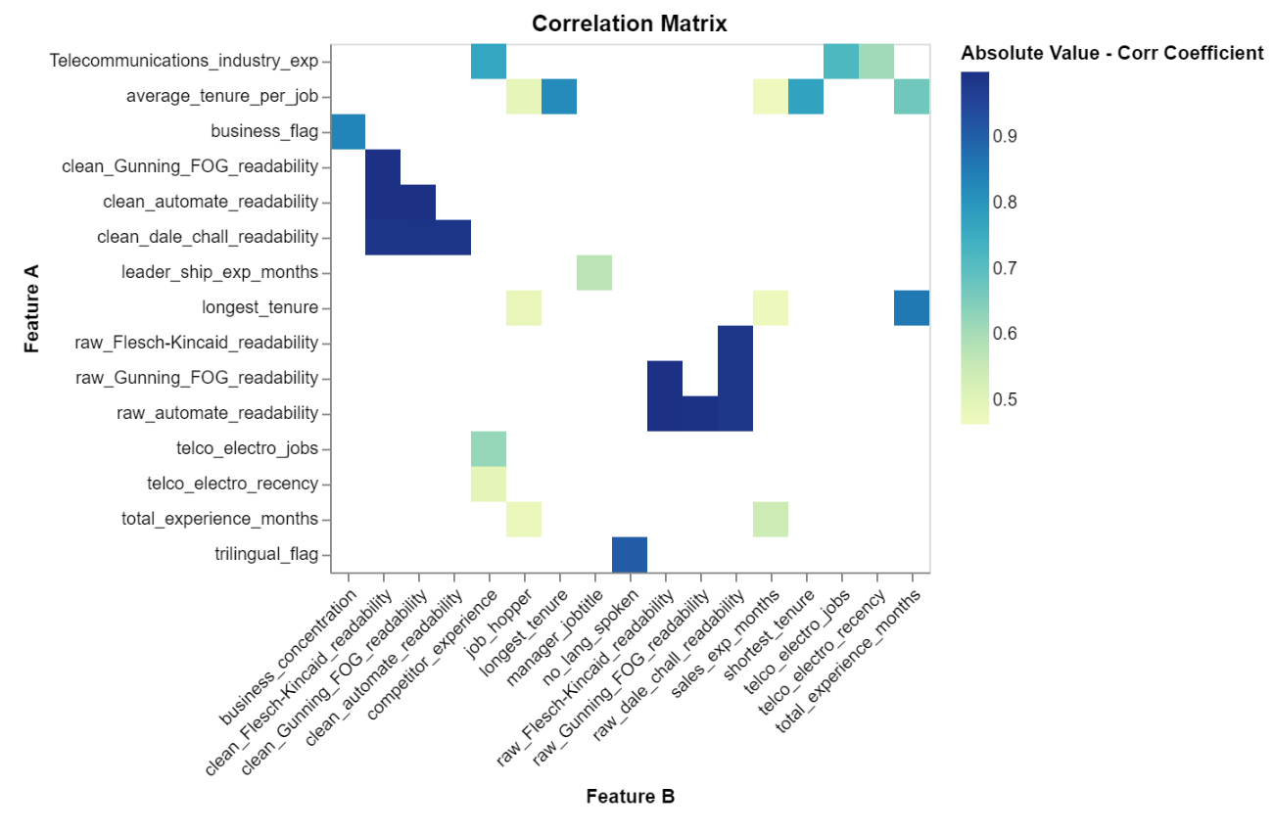
Feature Engineering – Correlation Matrix

Slide 38
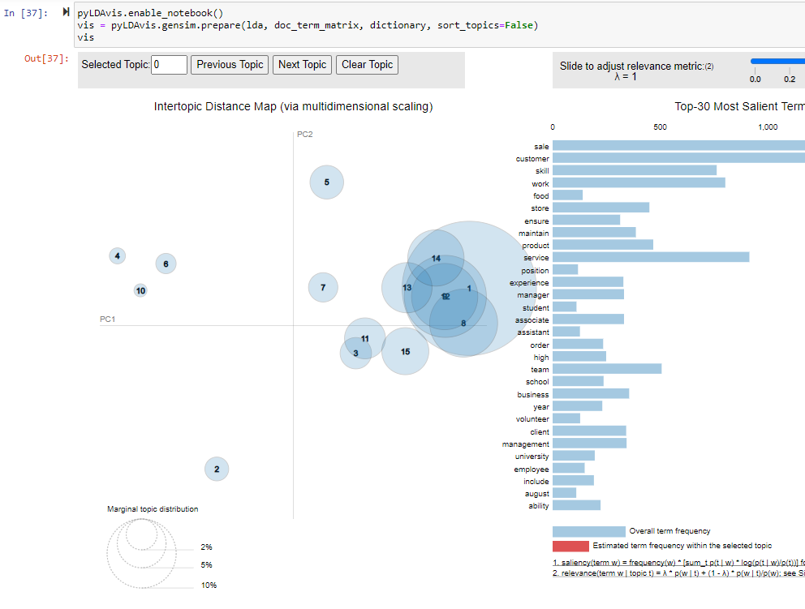
Topic Modelling
All Resumes
Data science
Fashion
Nutrition

Slide 39
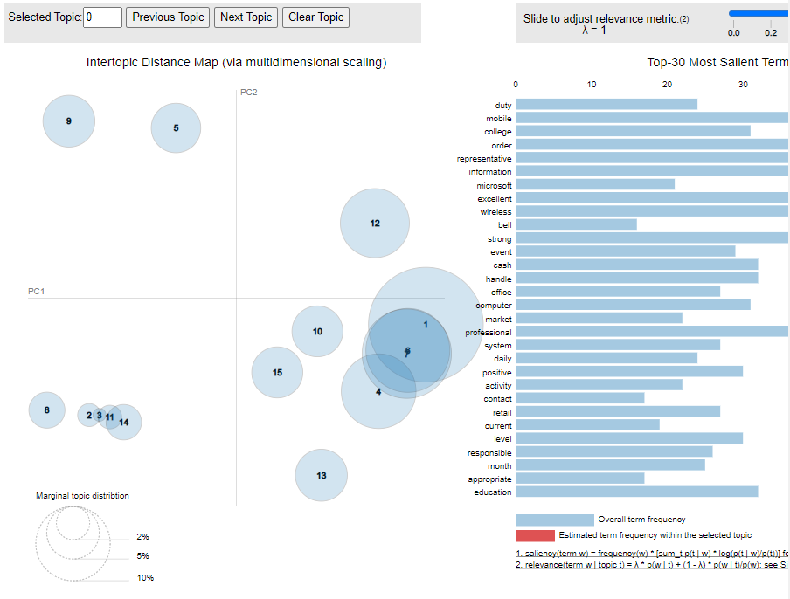
Topic Modelling
High Performers

Slide 40
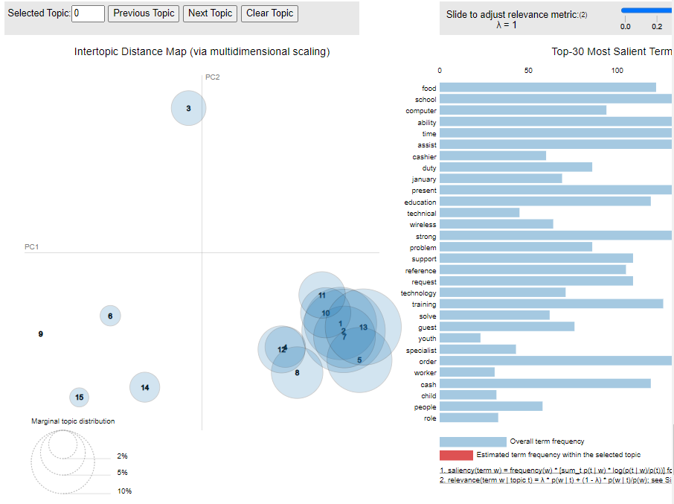
Topic Modelling
Low Performers

Slide 41
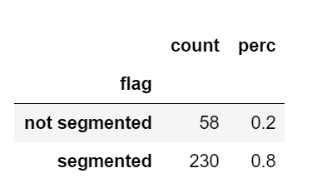
Information Retrieval

Slide 42
Feature Engineering - Features
68 features
From 11 feature groups

Slide 43
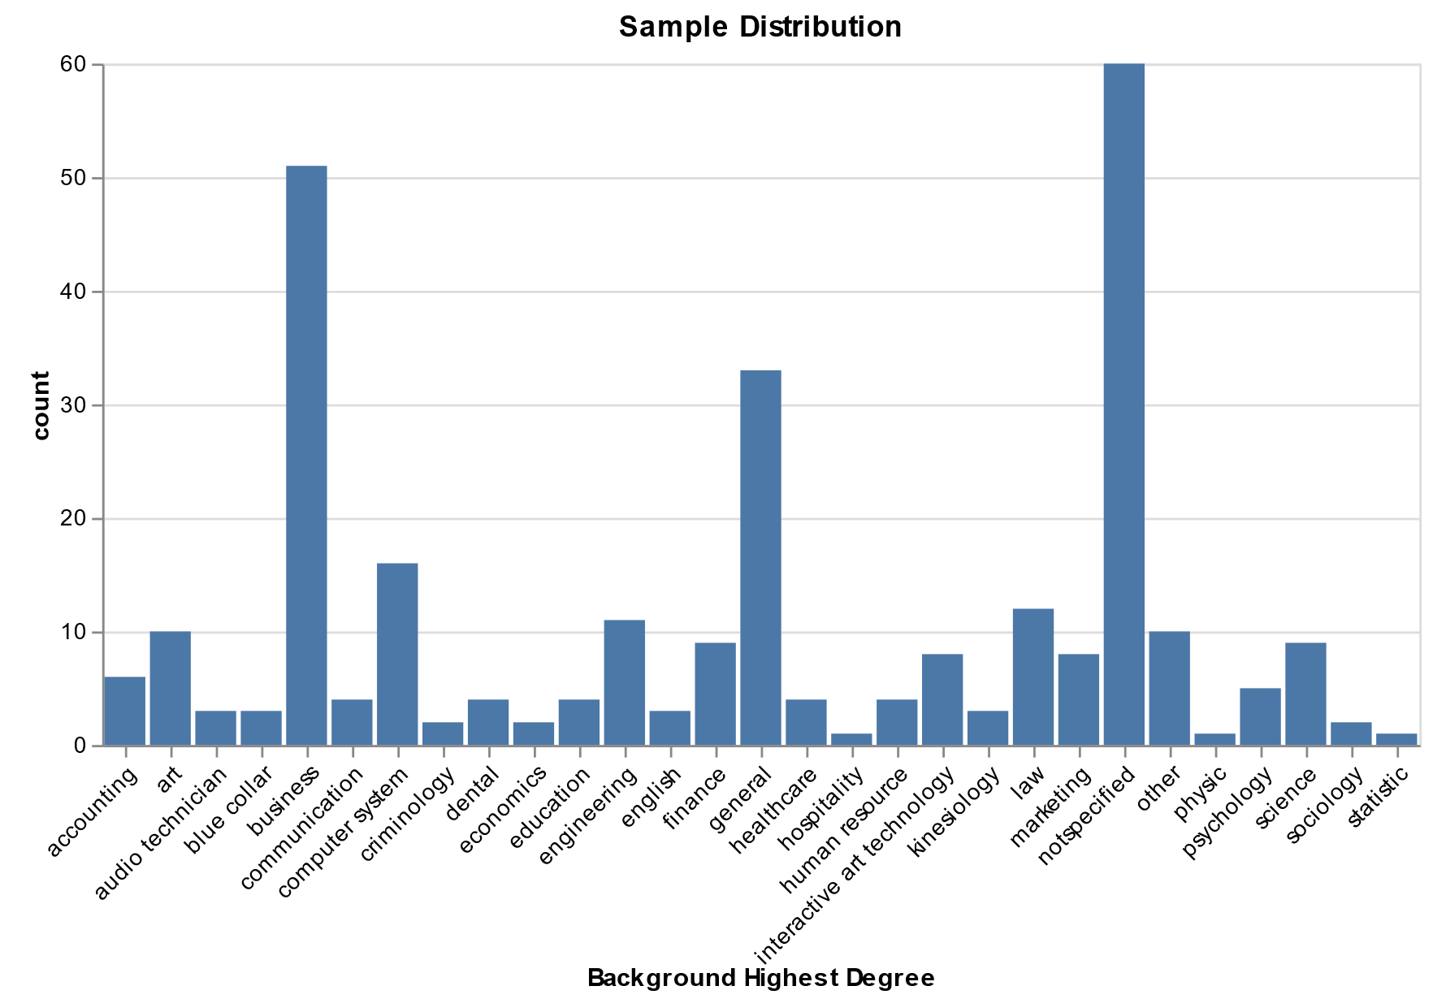
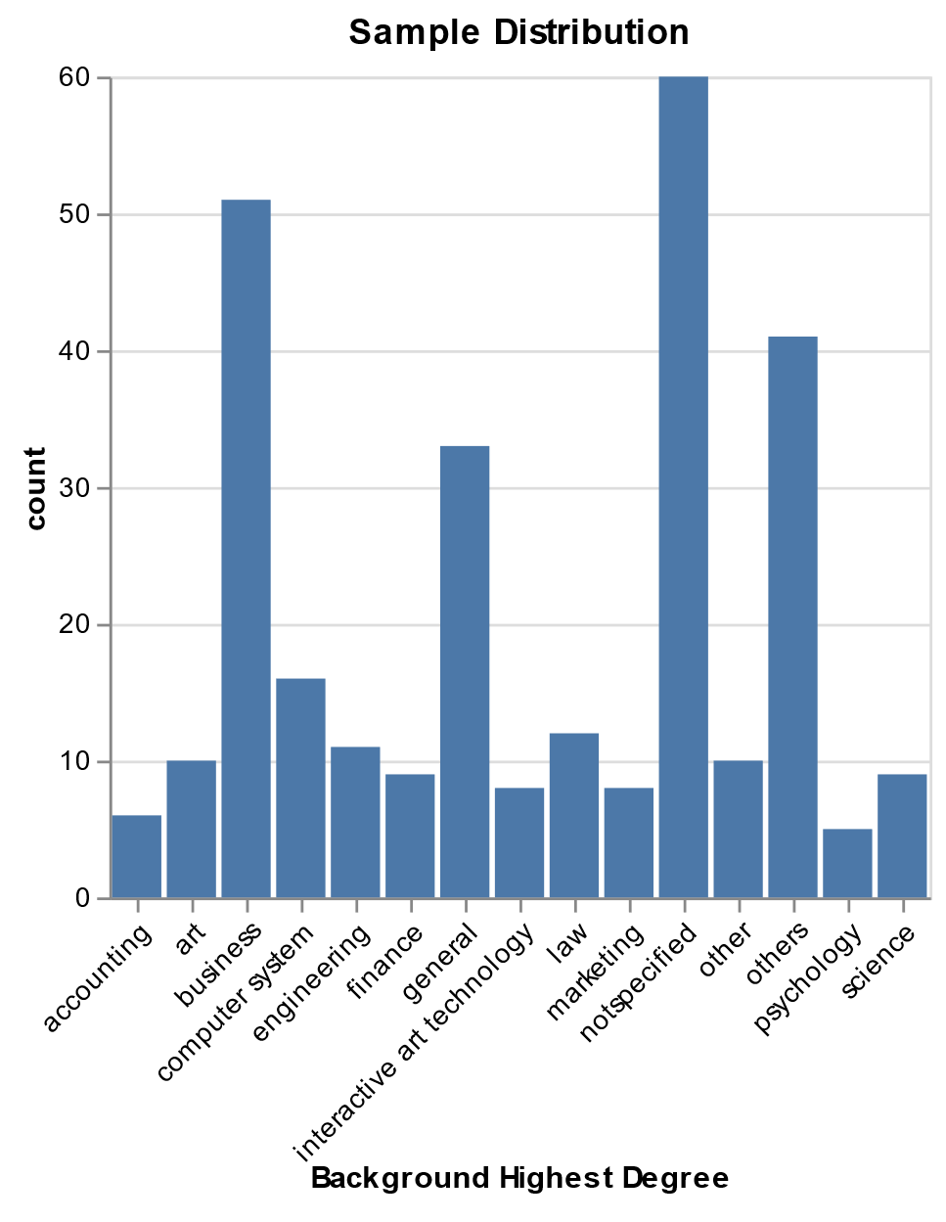
Feature Engineering - Grouping
Consolidated low count features to increase interpretability.

Slide 44
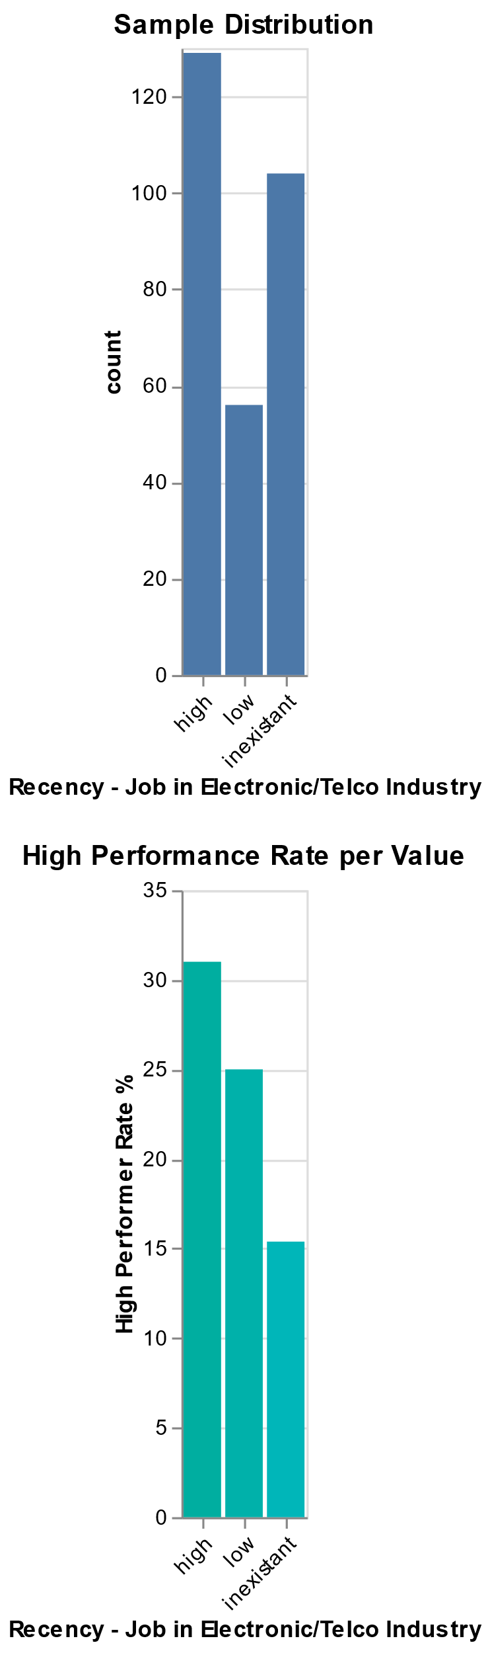
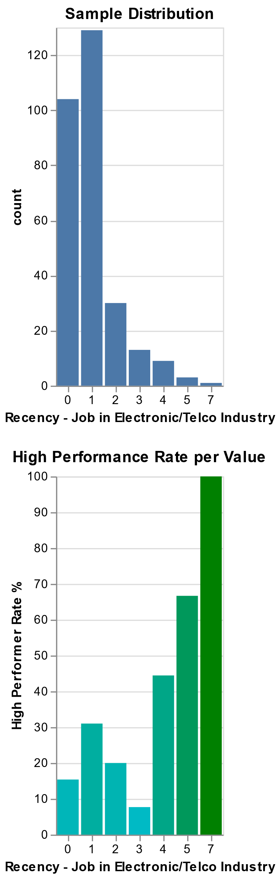
Feature Engineering - Grouping

Slide 45
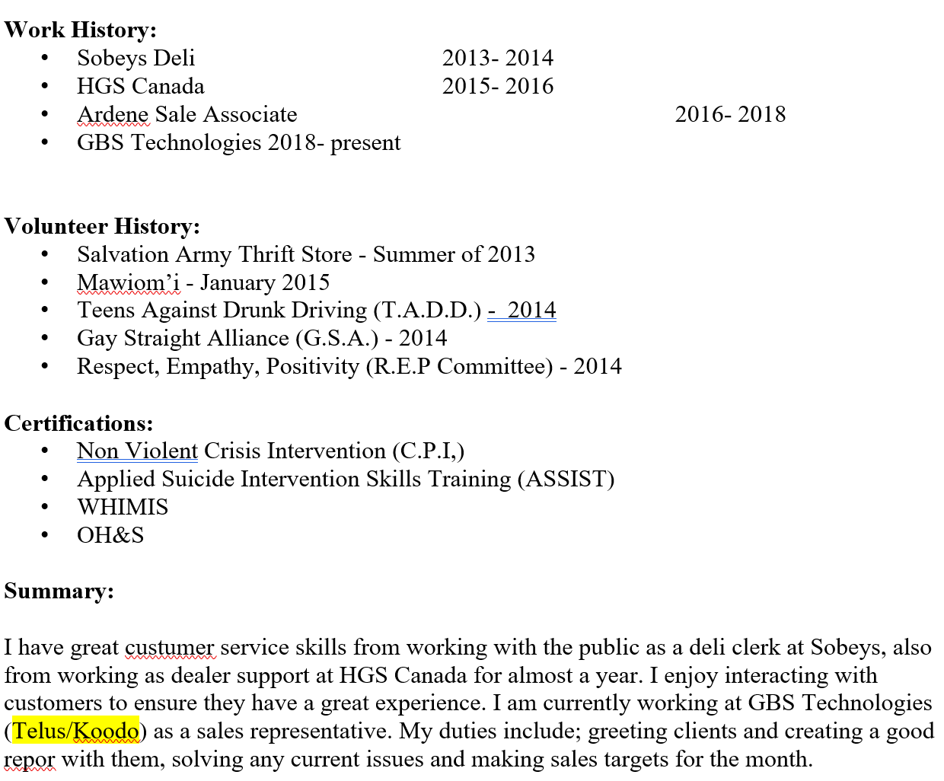
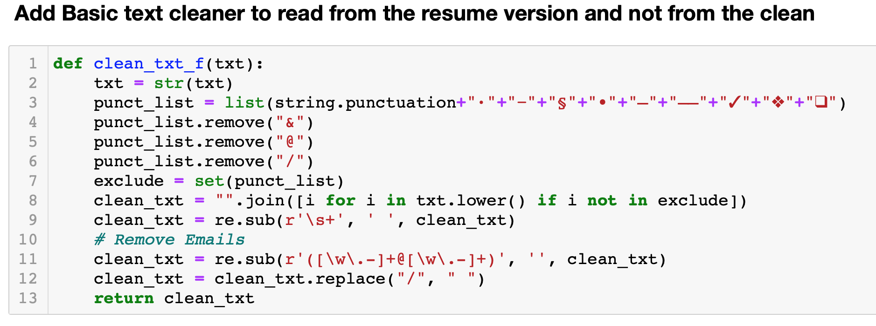
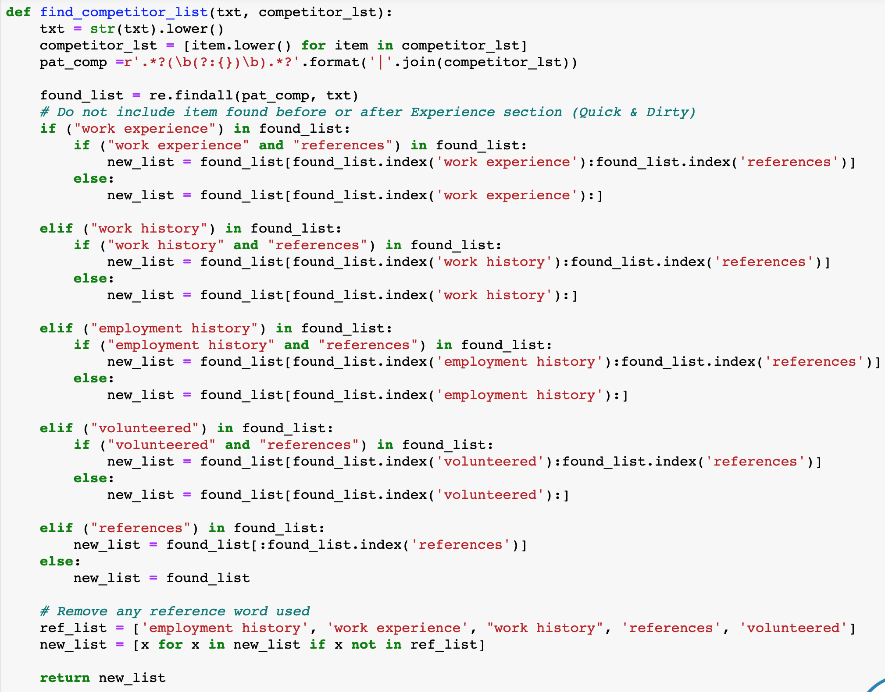
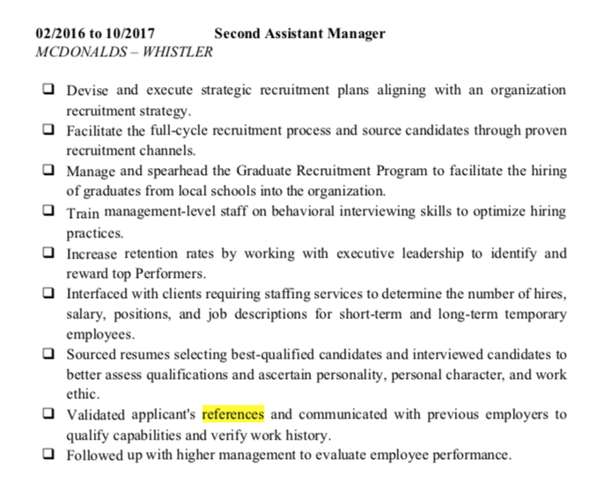
Information Retrieval Example
Automating Competitor Experience
Started with a difference of 50/146 (1/3) against companies identified manually.
Many false positive captured for the reference people e-mails
Had to designed different text cleaning techniques to read data directly and minimize loss of information
Segmented regex search between key words (Work History, Employment History, volunteered and References)
References motioned before competitor job
Solving one problem in one CV, many times created a problem in the others.
Lots of trial and error + lost of trouble shooting time.

Slide 46
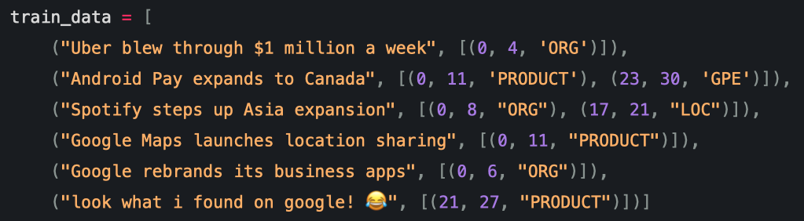
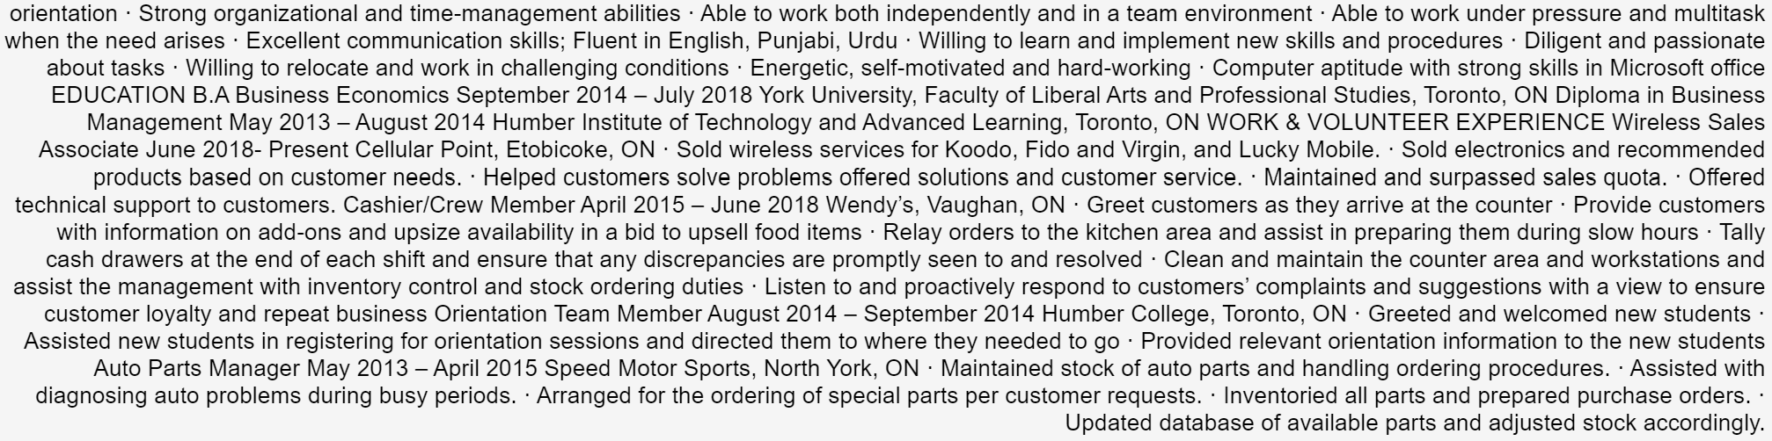
Issue with Spacy for training
Spacy (Limited extent)
Data cleaning
Text preprocessing for ML
Not for Entity recognition
Spacy Training format template
Too many systematic errors would have been generated

Slide 47

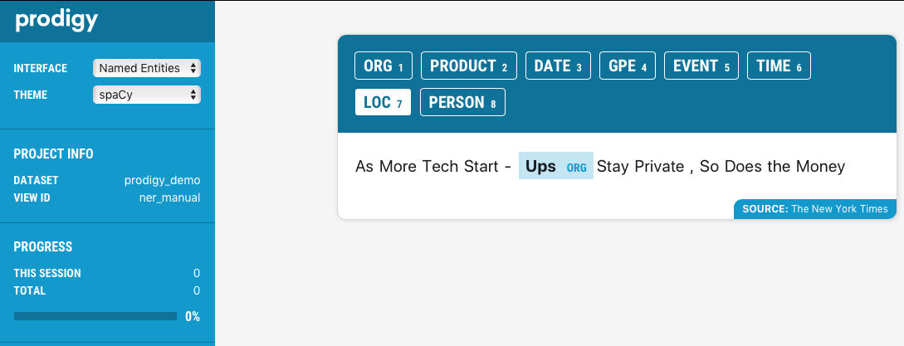
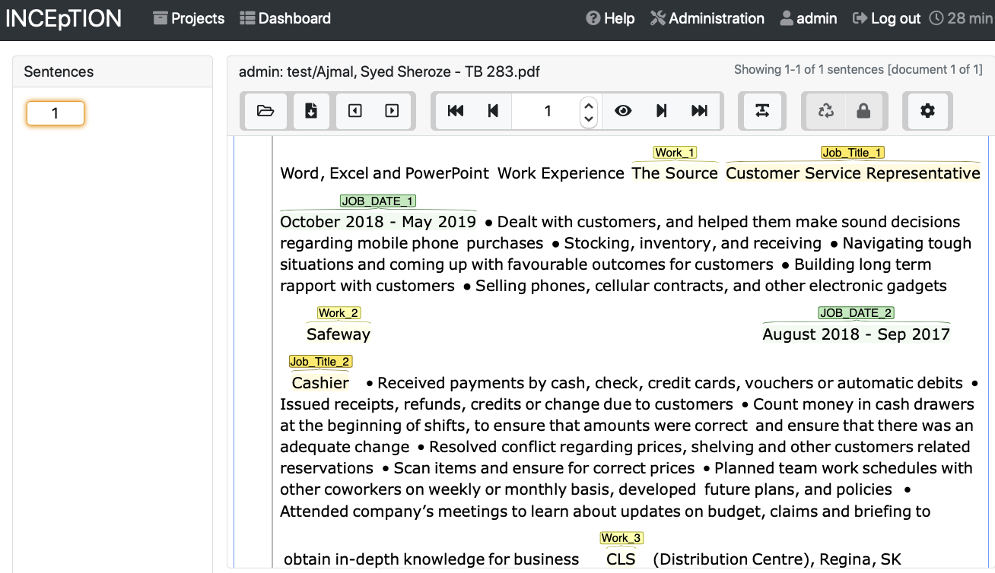

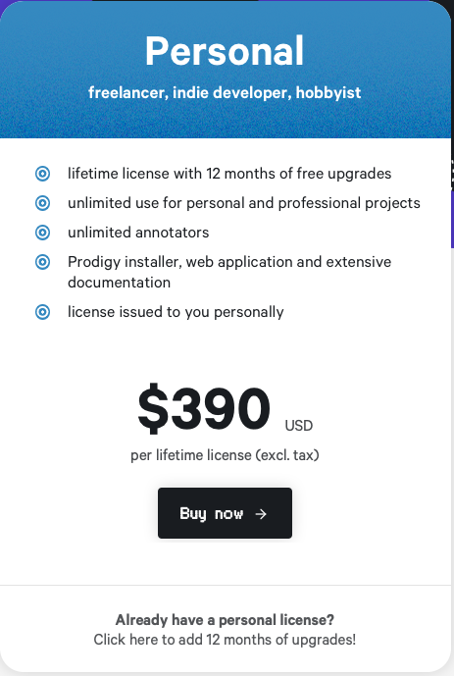
Methodology – Spacy + Annotation Tools
“From the Creators of Spacy ”

Slide 48
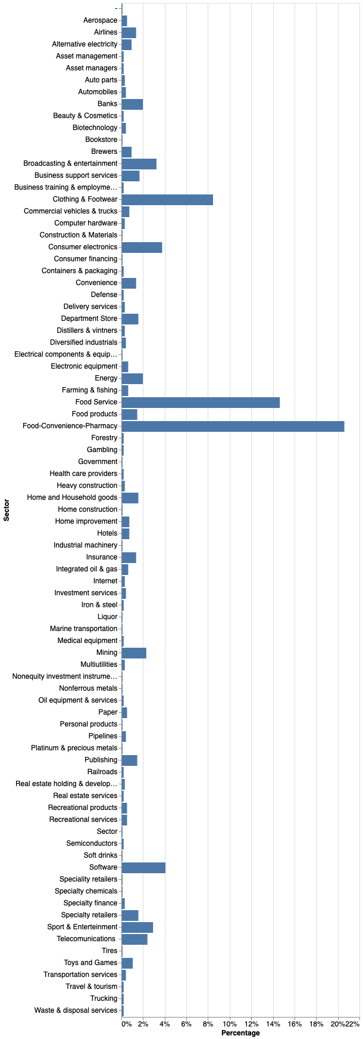
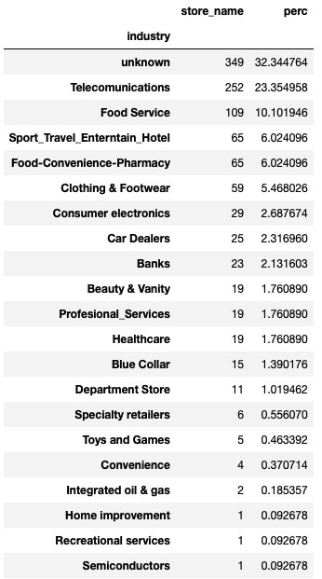
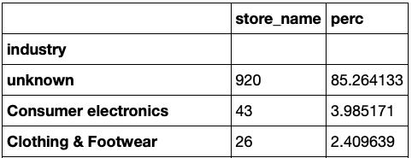
Methodology – Feature Engineering (Industry Characterization)
Wikipedia List
Characterized Dataset
Mall shops
Clothing & Footwear
Consumer Electronics
Food Service
Levenshtein – distance only
Food – Convenience- Pharmacy
Similarity
Key Words
REGEX
1079 Companies to identify
15% similarity algorithm.
53% key-words
32% unknown
Sports & Entertainment
Toys & Games

Slide 49
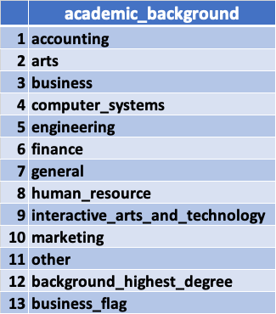
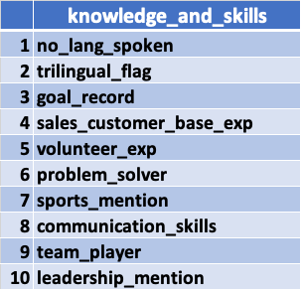
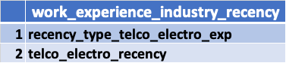
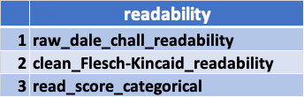
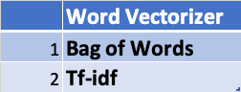
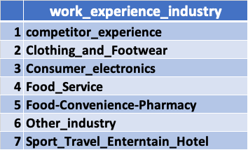
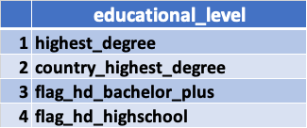
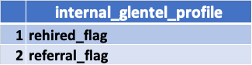
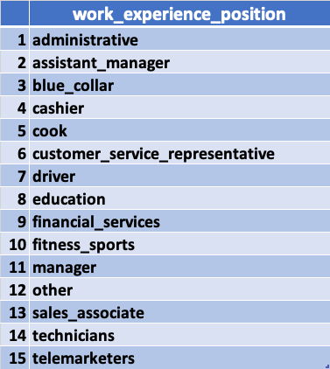
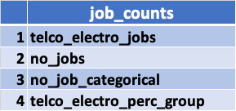
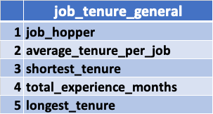
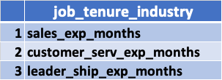
Methodology – Feature Engineering Summary
Final feature groups for modeling
Final Model Set
11 Feature groups
61 Numeric features
7 Categorical features
Categorical features

Slide 50

Appendix

Slide 51

Appendix

Slide 52


Slide 53


Slide 54


Slide 55


